Slide 1
Application Demo & Progress Update G3-T4 Gordon, Amey, Brian, Rou Hui, Ian

Slide 2
AGENDA
Functionalities
Schedule
Bug Metrics
Roles & Responsibilities
Pair programming teams & Rotation plan
Summary of Changes (Since PM Review)

Slide 3
FUNCTIONALITIES
1

Slide 4
ADDING FUNCTIONALITIES & PHP FRAMEWORKS
Team’s plans to add functionalities:
Student’s timetable
Searching for classes
Plans to use any PHP Frameworks?
No
Tight deadlines, may not have enough time to learn
Web application required isn’t too complex

Slide 5
IP ADDRESS & ADMIN PASSWORD
IP Address:
18.139.162.53
Admin Password:
P@ssword2
*Update following PM Review
changed admin password to P@ssword2 to ensure it’s confidential and secure after PM review

Slide 6
FUNCTIONALITIES COMPLETED (UPDATED)
Student:
Login
Bid for a section
Drop a bid
Drop a section
Round 2 view real-time bids
Admin:
Login
Bootstrap
Round 1 Starting & Clearing
Round 2 Starting & Clearing

Slide 7
SCHEDULE
2

Slide 8
TEAM SCHEDULE
31 Oct – 13 Nov
(14 Days)
*Update following PM Review
Planned for 5 iterations with 5 PMs instead of only 4 previously. Timeline is adjusted accordingly
3 Oct – 16 Oct
(14 Days)
Iteration 4
Iteration 2
Week 3
Week 4
Week 5
Week 6
Week 7
Week 8
Week 9
Week 10
Week 11
Week 12
Week 13
Week 14
2 Oct
16 Oct
30 Oct
20 Nov
Interim Review Presentation
Status Review
UAT
Final Presentation
Iteration 5
Iteration 1
Iteration 3
14 Nov – 20 Nov
(7 Days)
19 Sept – 2 Oct
(14 Days)
17 Oct – 30 Oct
(14 Days)

Slide 9
Iteration Tasks
Iteration 1
Week 5
Week 6
Week 7
Project Manager: Gordon
Iteration 1: Planning – All Members
Design database structure – Brian & Ian
Code student login process– Amey & Rou Hui
Basic CSS design– Brian & Ian
Code remaining DAOs – Brian & Ian
Code common files – Amey & Rou Hui
Code bootstrap– Brian & Ian
Integrate code– Amey & Rou Hui

Slide 10
Iteration Tasks
Iteration 1
Continued…
Week 5
Week 6
Week 7
Project Manager: Gordon
Test code – All Members
Debug code – Brian & Ian
Deploy to AWS – Brian & Ian
Iteration 1: Second meeting (Plan round 1) – All members
Student bidding (add, drop) – Amey & Rou Hui
Student bidding (view results) – Brian & Ian
Round 1: Admin Clearing Logic – Brian & Ian
Iteration 1: Third meeting (PM review prep) – All members
PM review– All members

Slide 11
Iteration Tasks
Iteration 2
Week 7
Week 8
Week 9
Project Manager: Amey
Iteration 2: Planning – All members
Round 2 View Real Time Bids – Gordon & Ian
Round 2 Clearing Logic and View Results – Brian & Rou Hui
Integrate code – Gordon & Ian
Test code – All members
Debug code – Brian & Rou Hui
Deploy code to AWS – Gordon & Ian
Online Review Preparation – All members
Online review – Gordon & Ian

Slide 12
Iteration Tasks
Iteration 3
Week 9
Week 10
Week 11
Project Manager: Ian
Iteration 3: Planning – All members
Code timetable – Gordon & Rouhui
Code search bid – Amey & Brian
Integrate code – Gordon & Rouhui
Test code – All members
Debug code – Amey & Brian
Deploy to AWS – Gordon & Rouhui
Iter 3 second meeting – All members
UI Design– Amey & Brian
UAT – All members

Slide 13
Iteration Tasks
Iteration 4
Week 11
Week 12
Week 13
Project Manager: Rou Hui
Preparation - Schedule – All members
Preparation - Bug Metric – All members
Preparation - Use of GIT – All members
Preparation - Others – All members
Final Submission – All members
*Update following PM Review
Re-planned certain tasks in response to adding a new iteration (5)

Slide 14
Iteration Tasks
Iteration 5
Week 13
Week 14
Project Manager: Brian
Final Presentation Preparation – All members
Final Presentation – All members
*Update following PM Review
Additional iteration (5) planned

Slide 15
MILESTONES & RESPECTIVE PMs
Gordon
Amey
Ian
Rou Hui
Brian
Week 7
Week 9
Week 11
Week 13
Week 14
Milestone 1
Milestone 2
Milestone 3
Milestone 4
Milestone 5
PM Review
Application Demo & Progress Update
User Acceptance Test (UAT)
Final Submission
Final Presentation
*Update following PM Review
5 milestones in total instead of 4. Each team member will be the PM in-charged of each milestone

Slide 16
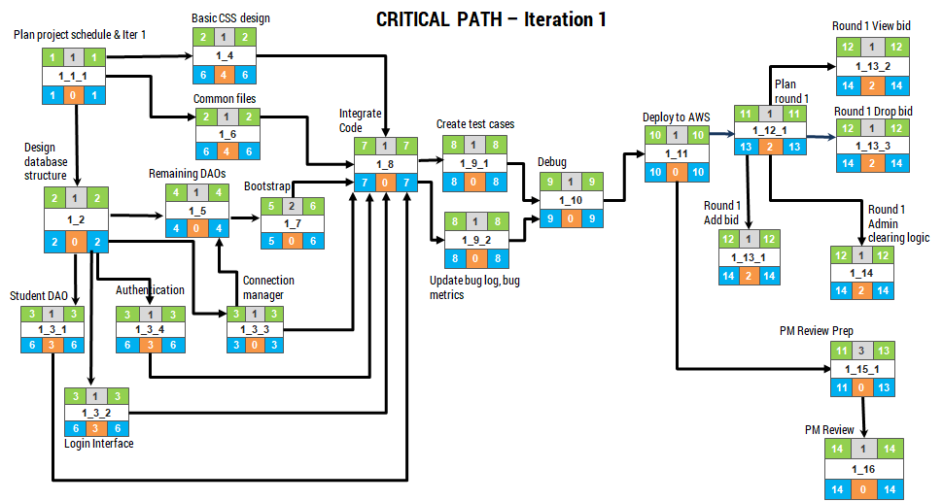
1_1_1 → 1_2 → 1_3_3 → 1_5 → 1_7 → 1_8 → 1_9_1, 1_9_2 → 1_10 → 1_11 → 1_15_1 → 1_16

Slide 17
Critical Path – Iteration 2
View round 1 results
2
1
2
2_2_1
4
2
4
Plan iter 2
Round 2 view bid
Integrate code
1
1
1
2
3
4
5
1
5
2_1
2_2_2
2_3
1
0
1
2
0
4
5
0
5
Round 2 admin clearing
2
2
3
2_2_3
6
1
6
Create test cases
2
0
3
2_4_1
6
0
6
Update bug metrics
Debug code
Deploy code to AWS
4
1
4
7
3
9
10
1
10
11
1
11
12
1
12
2_2_4
2_4_2
2_4_3
2_5
2_6
4
0
4
7
0
9
10
0
10
11
0
11
12
0
12
View round 2 results
JSON authentication, update bug log
Online review
Online review prep
13
1
13
14
1
14
2_7_1
2_8
13
0
13
14
0
14
2_1 → 2_2_2 → 2_3 → 2_4_1 → 2_4_2 → 2_4_3 → 2_5 → 2_6 → 2_7_1 → 2_8
2_1 → 2_2_3 → 2_2_4 → 2_3 → 2_4_1 → 2_4_2 → 2_4_3 → 2_5 → 2_6 → 2_7_1 → 2_8

Slide 18
Critical Path – Iteration 3
Code timetable
Plan iter 3
2
3
4
3_2
1
1
1
2
0
4
3_1
UAT Preparation
UAT
1
0
1
Code bid search
5
1
5
Integrate code
2
3
4
3_4
11
3
13
14
1
14
3_3
5
0
5
3_8_1
3_9
2
0
4
11
0
13
14
0
14
Create test cases
6
1
6
Deploy to AWS
3_5_1
10
1
10
6
0
6
3_7
10
0
10
Update bug log & bug metrics
7
1
7
8
2
9
3_5_2
3_6
7
0
7
8
0
9
Debug code
2
3
4
3_10
7
5
9
3_1 → 3_2, 3_3 → 3_4 → 3_5_1 → 3_5_2 → 3_6 → 3_7 → 3_8_1 → 3_9
UI Design

Slide 19
Critical Path – Iteration 4
Preparation - Schedule
Preparation - Bug metric
Preparation - Use of GIT
Preparation - Others
1
3
3
4
3
6
7
3
9
10
3
12
4_1_1
4_1_2
4_1_3
4_1_4
1
0
3
4
0
6
7
0
9
10
0
12
13
1
13
4_1_1 → 4_1_2 → 4_1_3 → 4_1_4 🡪 4_2
4_2
13
0
13
Final Submission
*Update following PM Review
Critical path for iteration 4 is updated accordingly (as per the updated schedule following the addition of iteration 5)

Slide 20
Critical Path – Iteration 5
Final Presentation Preparation
Final Presentation
1
6
6
7
1
7
5_1
5_2
1
0
6
7
0
7
5_1 🡪 5_2
*Update following PM Review
Critical path for iteration 5 is added. Previously, there was no iteration 5 planned.

Slide 21
BUG METRICS
3

Slide 22
Bug Metrics - Iteration 1
S/N | Iter | Function | Description | Severity | Points | Final Bug Metric (Total)
1 | 1 | Login | Admin username field was case sensitive - Resolved | Low | 1 | 9
2 | 1 | Student add bid, drop bid | Variable not found error when student access BIOS before admin conducts bootstrap - Resolved | Low | 1
3 | 1 | Sidebar navigation | Token wasn't passed when navigating through sidebar - Resolved | Low | 1
4 | 1 | Student add bid, drop bid | Submit button didn't pass token, causing student to get logged out after submitting - Resolved | Low | 1

Slide 23
Bug Metrics - Iteration 1
S/N | Iter | Function | Description | Severity | Points | Final Bug Metric (Total)
5 | 1 | Bootstrap | Temporary files were left un-deleted in temp folder - Resolved | Low | 1 | 9
6 | 1 | Bootstrap | The argument '0' was taken in as an empty field - Resolved | Low | 1
7 | 1 | Bootstrap | There is no validation for amount when it takes in non numeric values - Resolved | Low | 1
8 | 1 | Bootstrap | Maximum number of characters for userid was mistaken to be 128 instead of 100 - Resolved | Low | 1
9 | 1 | Bootstrap | Validation for description was slightly wrong (e.g. if(strlen($description > 1000)) ) where strlen($description > 1000) means strlen(true). - Resolved | Low | 1

Slide 24
Bug Metrics - Iteration 1
9
Final Value of Bug Metric for Iter 1
Mitigation: Use the planned debugging time in the iteration

Slide 25
Bug Metrics - Iteration 2
S/N | Iter | Function | Description | Severity | Points | Final Bug Metric (Total)
10 | 2 | Bootstrap | Perform bootstrapping which includes a bid from zac.ng(SOB student) for IS100 (IS course) - Resolved | High | 5 | 13
11 | 2 | Minimum e$10 | Bids less than e$10 were successful - Resolved | High | 5
12 | 2 | Error checking | When 2 errors were discovered ( Minimum bid cannot be less than e$10, you have already completed this course), the error numbering for both were 1 - Resolved | Low | 1
13 | 2 | Error checking | When section and bid amount are left empty, no errors are shown - Resolved | Low | 1
14 | 2 | Drop section | Error pops up when section is dropped!! Section has been dropped successfully but e$ has not been refunded - Resolved | Low | 1

Slide 26
Bug Metrics - Iteration 2 (Current Value)
0
Final Value of Bug Metric for Iter 2
Mitigation: Continue Development according to the schedule.

Slide 27
ROLES & RESPONSIBILITIES
4

Slide 28
PROJECT MANAGER ROTATION
*Update following PM Review
Appointed Rou Hui as the PM in-charge of iteration 4 following changes to our iteration plan
Iteration 1
Iteration 2
Iteration 3
Iteration 4
Iteration 5
PM: Gordon
PM: Amey
PM: Ian
PM: Rou Hui
PM: Brian
Coders: Brian, Ian, Amey, Rou Hui
Coders: Brian, Ian, Gordon, Rou Hui, Amey
Coders: Brian, Gordon, Amey, Rou Hui
Coders: N.A
Coders: N.A

Slide 29
PAIR PROGRAMMING TEAMS
5

Slide 30
PP Teams & Rotation Plan
PM: Amey
Pair 1: Gordon + Ian
Pair 2: Brian + Rou Hui
Pair 3: Amey + Rou Hui
*Update following PM Review
New rotation plan for updated iterations
PM: Rou Hui
Iteration 4
Iteration 2
Week 3
Week 4
Week 5
Week 6
Week 7
Week 8
Week 9
Week 10
Week 11
Week 12
Week 13
Week 14
2 Oct
16 Oct
30 Oct
20 Nov
Interim Review Presentation
Status Review
UAT
Final Presentation
Iteration 5
Iteration 1
Iteration 3
PM: Brian
PM: Gordon
Pair 1: Brian + Ian
Pair 2: Amey + Rou Hui
PM: Ian
Pair 1: Gordon & Rou Hui
Pair 2: Brian & Amey

Slide 31
SUMMARY OF CHANGES
6

Slide 32
SUMMARY OF CHANGES
Functionalities
Round 2 view real-time bids
Round 2 clearing logic
Updated admin password to ensure confidentiality
Schedule
Planned for 5 iterations with 5 PMs instead of only 4 previously. Tasks & scheduling timeline are adjusted accordingly
Bug Metrics
Updated bug metrics for iteration 2
Roles & Responsibilities
Adjusted PM rotation
Pair programming teams & Rotation plan
Changes to PP teams rotation with new iteration plan

Slide 33
End of Application Demo & Progress Update
Thank you

